Slide 1
Capital Structure Decisions around the World: Which Factors Are Reliably Important?
Özde Öztekin
Florida International University
Presented by Austin Francis

Slide 2
Research Question
What are the reliable determinants of capital structure on a global scale?

Slide 3
Prior Literature
The key factors for U.S. firms are industry leverage, market-to-book ratio, tangibility, profits, firm size, and inflation. (Frank and Goyal, 2009)
The G-7 Countries (Canada, France, Germany, Italy, Japan, the United Kingdom, and the United States) have the following dominant factors: market-to-book ratio, tangibility, profits, firm size. (Rajan and Zingales, 1995)
Do these factors extend to a much larger panel of countries?

Slide 4
Data Collection
Nonfinancial and unregulated firms in the Compustat Global Vantage database from 1991 to 2006.
15,177 firms from 37 countries. A total of 101,264 firm-years.

Slide 5
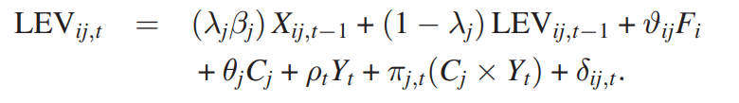
Models Used
Leverage Determinants Model
Notes:
Describe each portion of the model here. Also, indicate that leverage is long term debt + short term debt / total assets Lambda = adjustment speed to capital structure. Xij = firm, industry, macroeconomic facts from the previous year 1 – lambda = persistence of leverage, shows how much of the leverage ratio from the previous year carries over F = firm fixed effects y = year fixed effects C = country fixed effects C x Y = country and year rixed effects

Slide 6
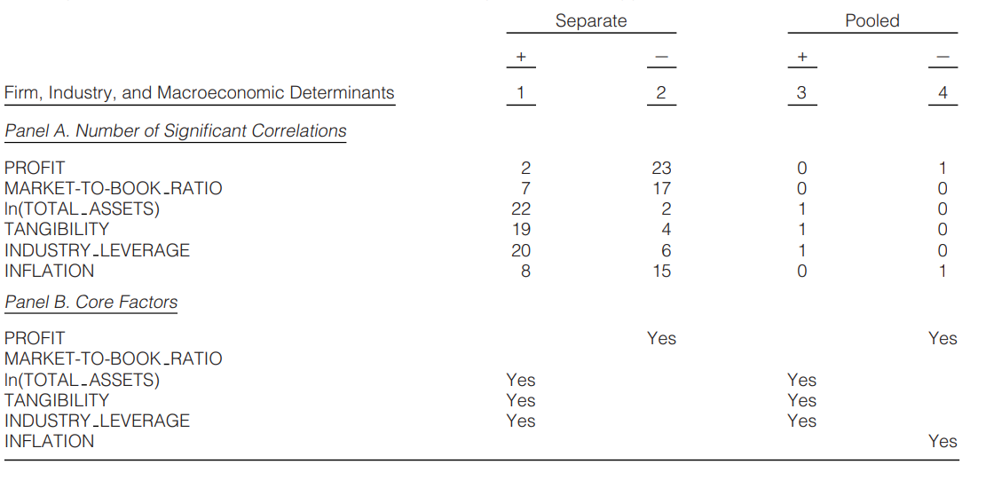
Table 1 – Reliable Firm, Industry, and Macroeconomic Determinants
Notes:
Separate = separate countries. Pooled = together. Number of instances where that coefficient was positive or negative

Slide 7
Table 1 Takeaways
Profits, firm size, tangibility, industry leverage, and inflation are dominant factors across all firms around the world.

Slide 8
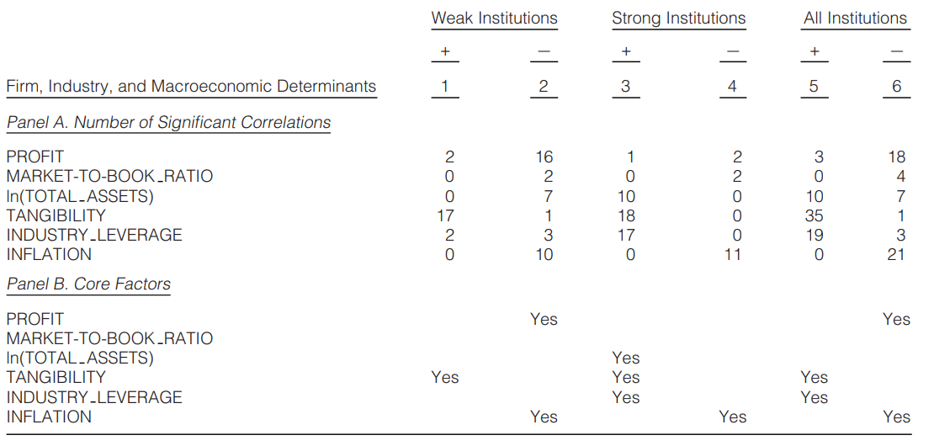
Table 2 – Effects of Institutions on Determinants of Leverage

Slide 9
Table 2 Takeaways
Profits are a core factor only in weak institutional settings
Size and Industry leverage are core factors only in strong institutional settings

Slide 10
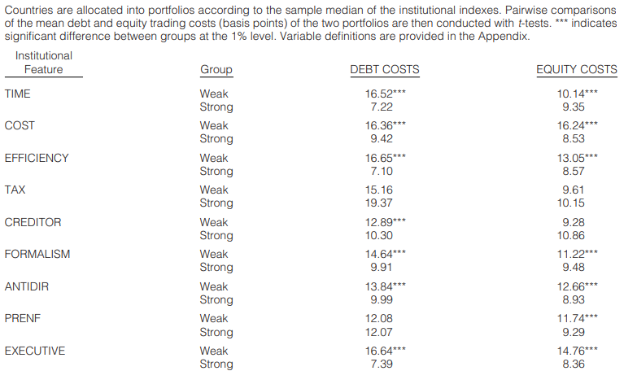
Table 3 – Institutional Determinants of Debt and Equity Trading Costs

Slide 11
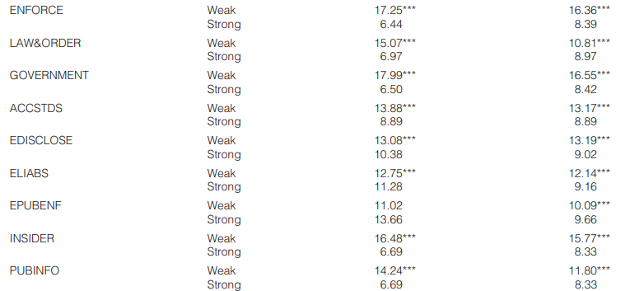
Table 3 – Institutional Determinants of Debt and Equity Trading Costs

Slide 12
Table 3 Takeaways
Stronger institutions have lower debt and equity costs
This should lead to faster adjustment speeds to optimal leverage

Slide 13
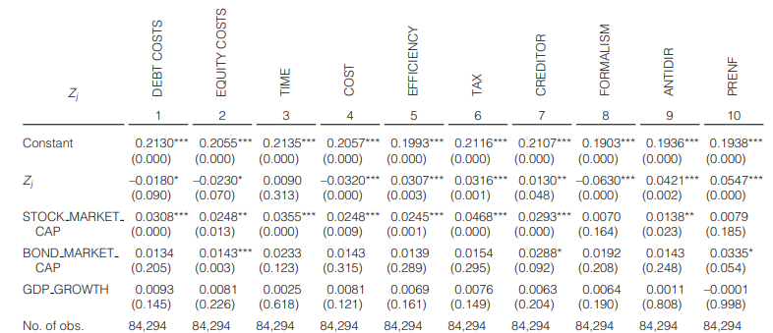
Table 4 – Effect of the Institutional Setting on Adjustment Speeds
Notes:
Institutional variables are normalized to have a mean of zero and standard deviation of 1

Slide 14
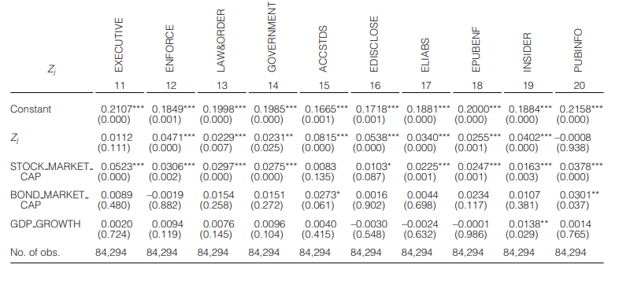
Table 4 – Effect of the Institutional Setting on Adjustment Speeds

Slide 15
Table 4 Takeaways
Increased debt and equity trading significantly slow down the adjustment speed
Countries with more efficient bankruptcy processes experience faster adjustment speed
Average adjustment speed is 21%, indicating a relatively quick adjustment towards optimal leverage with a half-life of 3.5 years

Slide 16
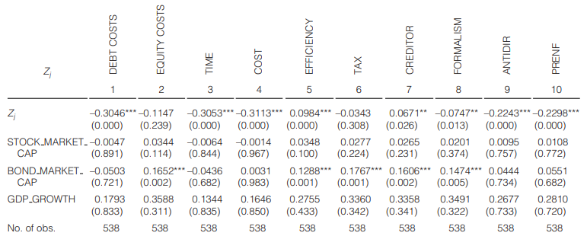
Table 5 – The Effect of Institutional Setting on Leverage

Slide 17
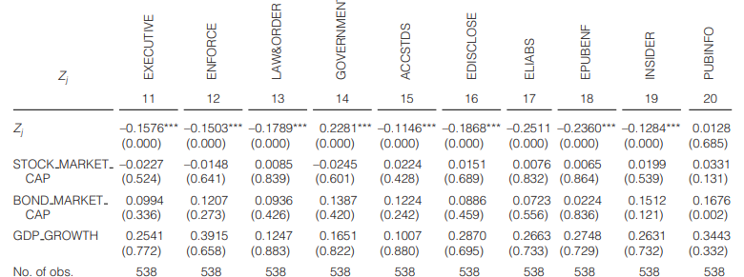
Table 5 – The Effect of Institutional Setting on Leverage

Slide 18
Table 5 Takeaways
An increase in debt costs by 1 S.D. decreases a firm leverage by 30%
No statistically significant effect for equity costs
Other positive effects: creditor rights, ualityof government
Other negative effects: shareholder rights, executive quality, stronger law and order

Slide 19
Conclusion
There are significant institutional impacts on Capital Structure
Firm size, Tangibility, Industry leverage, and inflation are reliable determinants of leverage
Cross-country differences are closely linked to institutional quality

